Slide 1
SML
Getting started

Slide 2
Go to the SMLNJ site
http://www.smlnj.org/
and download and install the most current release of SML.

Slide 3
Executing a Program
(* our first SML program *)
print “hello world”;
Execute the program directly from the command line.
Execute the program from within the SMLNJ interpreter.
Execute the program indirectly using a script (e.g., dot-bat).
Execute the program from within a suitable editor or IDE.

Slide 4
(* revision of our first SML program *)
print “\n\nhello world\n\n”;

Slide 5
Command line execution from the current working directory
sml < filename.sml
Assumes that filename.sml resides in the current working directory.

Slide 6
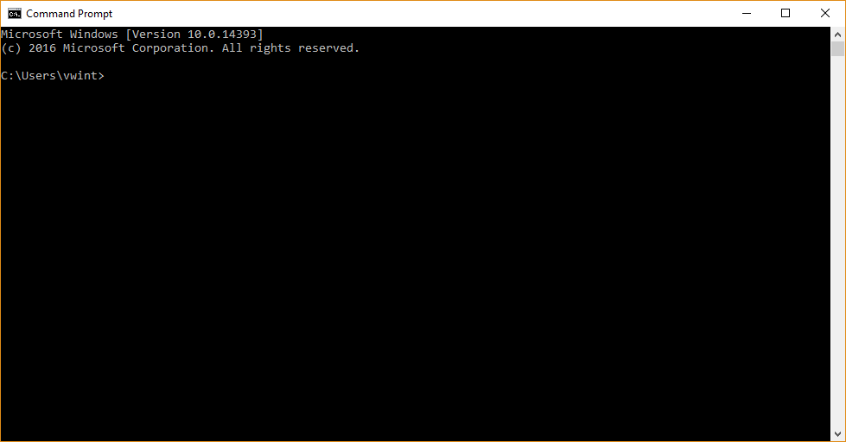

Slide 7
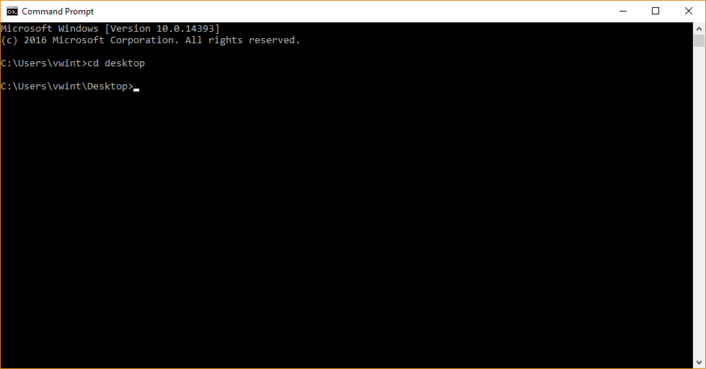

Slide 8
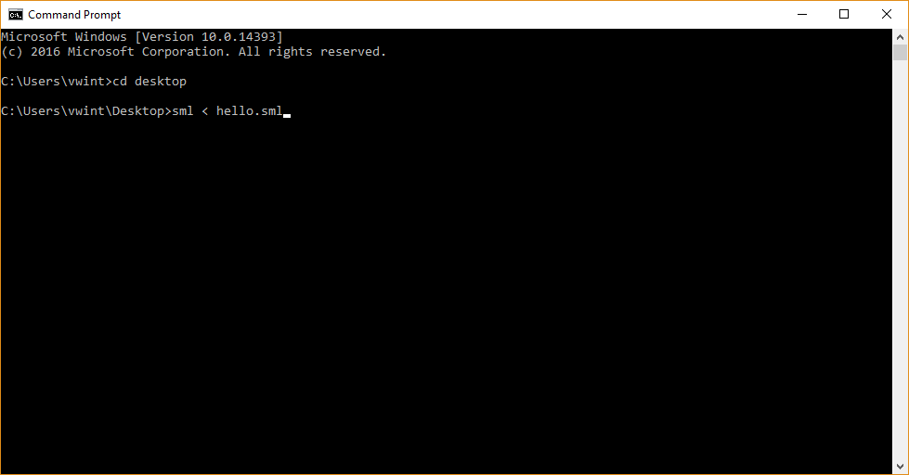

Slide 9
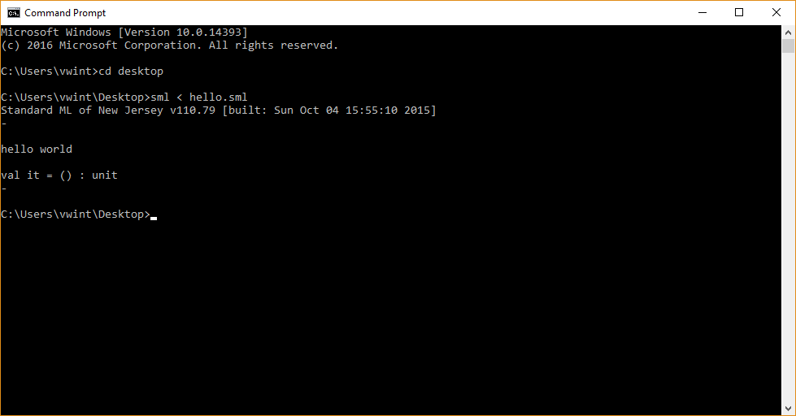

Slide 10
Command line execution using fully qualified name
sml < fully-qualified-name

Slide 11
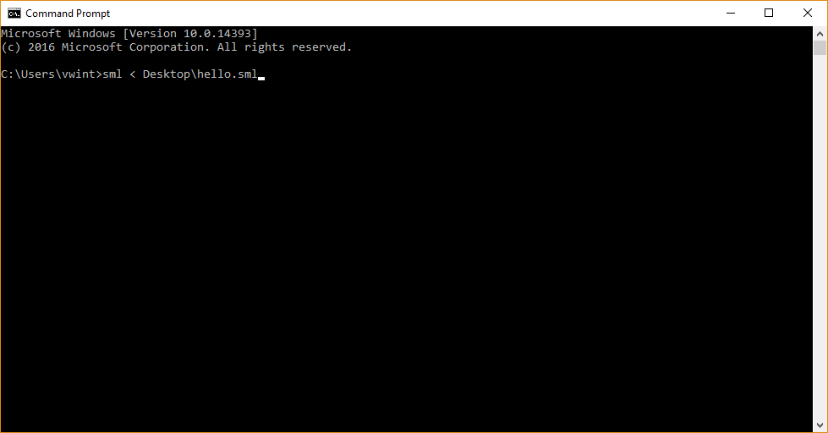

Slide 12
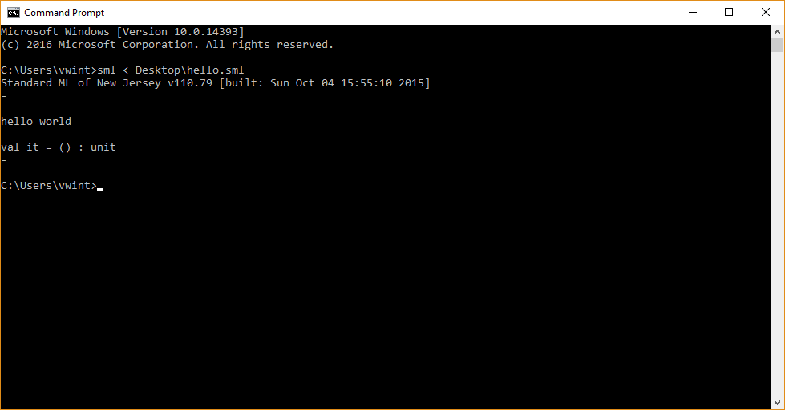

Slide 13
Loading a file from within the sml interpreter
On a Windows system a bat file that launches the interpreter can be found at:
C:\Program Files (x86)\SMLNJ\bin\sml.bat

Slide 14
Loading a file from within the sml interpreter
Programs can be entered into the interpreter from the keyboard.
The interpreter command to load a file is:
use “fully qualified name”;
The backslash symbols (e.g., in a fully qualified name) are special symbols (an escape symbol) in SML.
Translate the backslash symbols in a fully qualified name in one of the following two ways.
\ → /
\ → \\

Slide 15
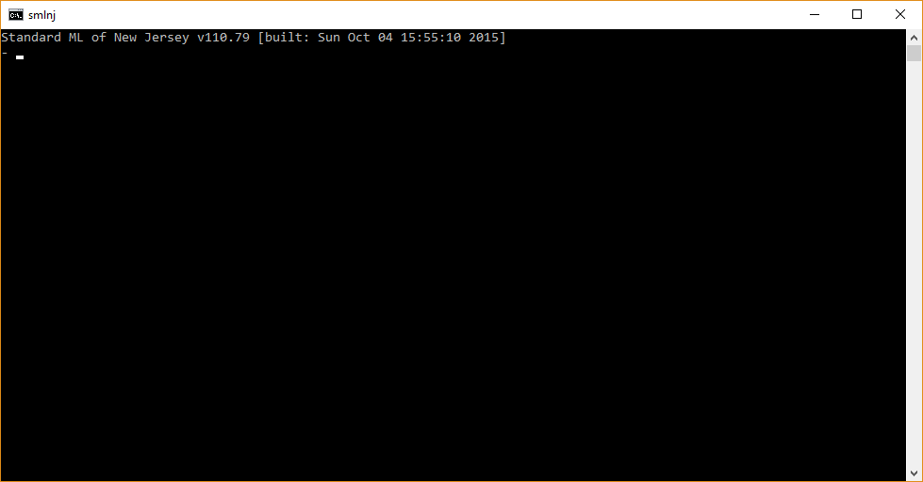

Slide 16
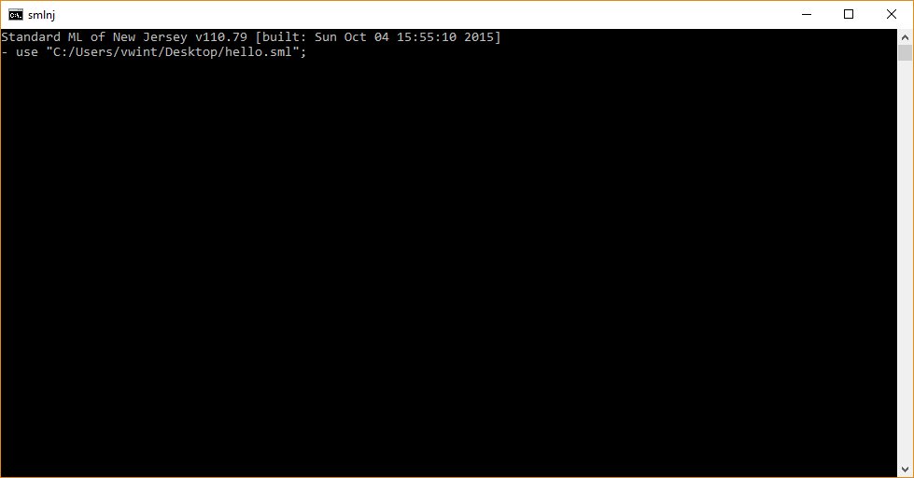

Slide 17
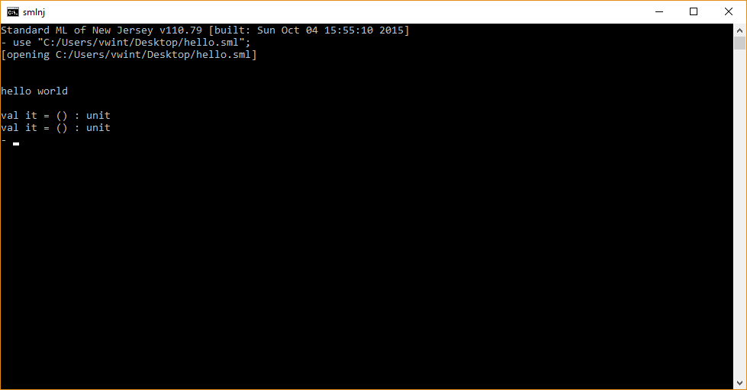

Slide 18
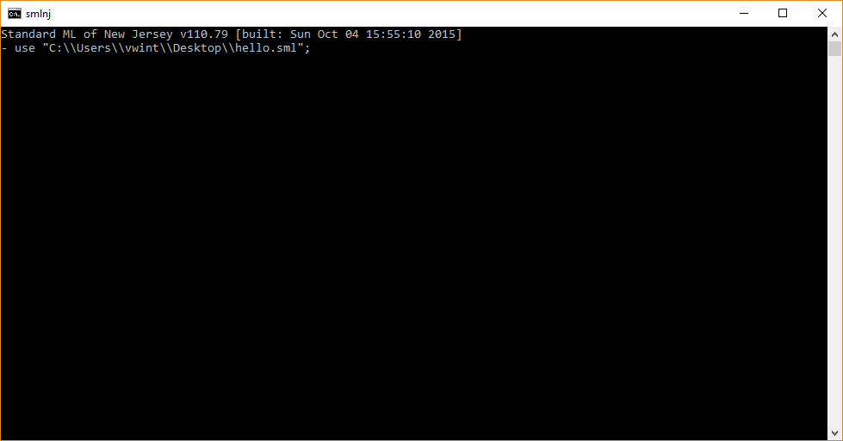

Slide 19


Slide 20
Scripts
Executing SML programs through scripts

Slide 21
DOS Scripts containing hard-coded file names
Option 1 – The script is in the same directory as the dot-sml file.
Option 2 – The script is in a different directory as the dot-sml file.
call sml hello.sml
pause
call sml fully-qualified-name
pause

Slide 22
DOS Scripts using variables
Click on sml file and then select “open with”.
Be careful if you set “Always use this app to open .sml files”.
call sml %1
pause

Slide 23
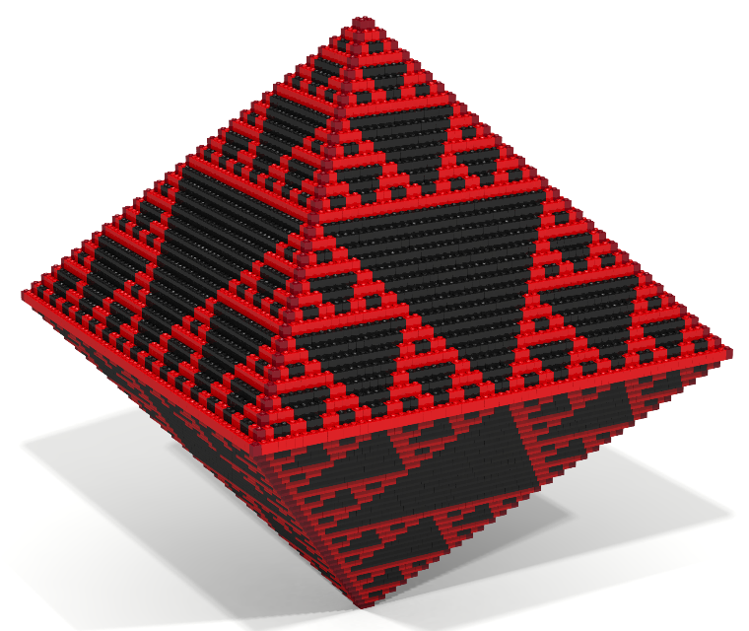
Using the bricklayer IDE

Slide 24
Bricklayer
Bricklayer is a graphical library, written in SML, that I created.
Bricklayer enables SML programs to create a variety of 2D and 3D artifacts.
Bricklayer programs have a dot-bl extension.
Viewers for artifacts created in Bricklayer include:
LEGO Digital Designer
Ldraw
3D Builder
Minecraft
For more information about Bricklayer visit
bricklayer.org

Slide 25
Windows
The Bricklayer IDE is a dot-exe file.

Slide 26
Mac os
Download and open the Bricklayer dmg file. If you have administrator privileges and wish to install the Bricklayer client for all users on the computer, simply drag the Bricklayer application to the Applications folder link shown in the dmg window. Otherwise, drag the bricklayer application to a directory of your choosing. After placing the Bricklayer application in a directory, you may drag the Bricklayer application into the dock.

Slide 27
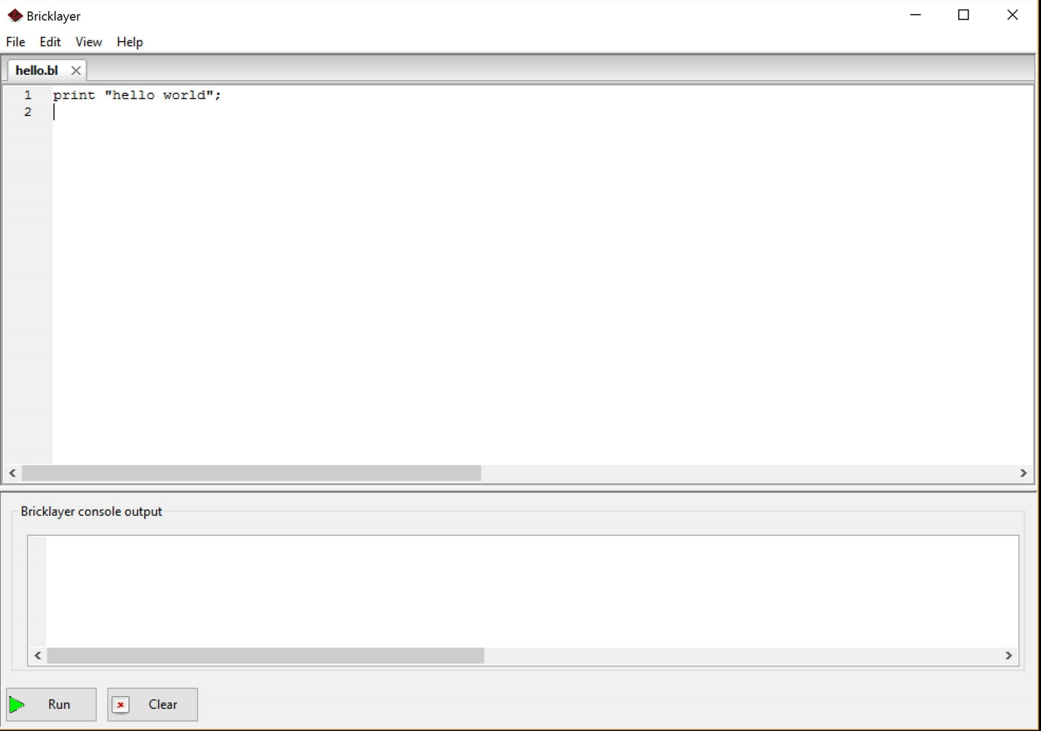

Slide 28
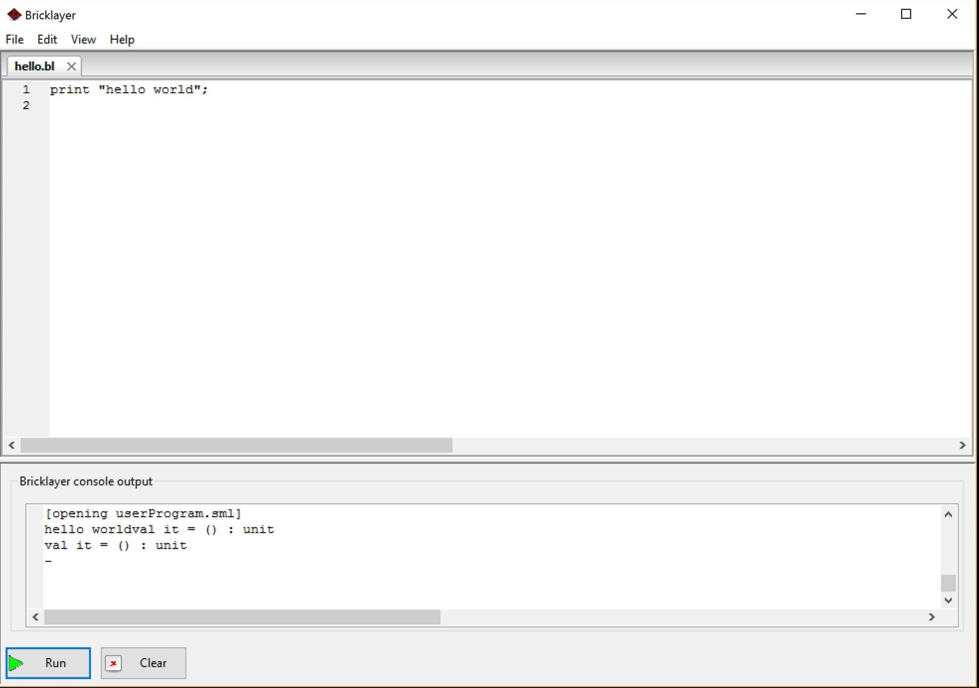

Slide 29
The end

